Slide 1

Cognizant [ADM21DF006] [Airport Management System]

Slide 2
Team
Vishal Kumar (POD Leader)
Sumit Kumar Labh (Member)
Abhishek Kumar (Member)
Sumit Kumar (Member)
Harshit Anand (Member)

Slide 3
Technologies
Platform: Visual Studio 2019, GitHub, Docker
Database: SQL server, Entity Framework Core
Cloud: Azure
Language: C#, HTML, CSS, JAVASCRIPT, BOOTSTRAP, Asp Dotnet Core

Slide 4
Overview
The project named “Airport Management System” is a web application using which employees can register their account by providing the required details.
After successful login they will be redirected to their respective home pages based on the profile from where they can perform certain actions which are available for them like checking their work schedule, raising queries, available flight slots, rescheduling and many more.

Slide 5

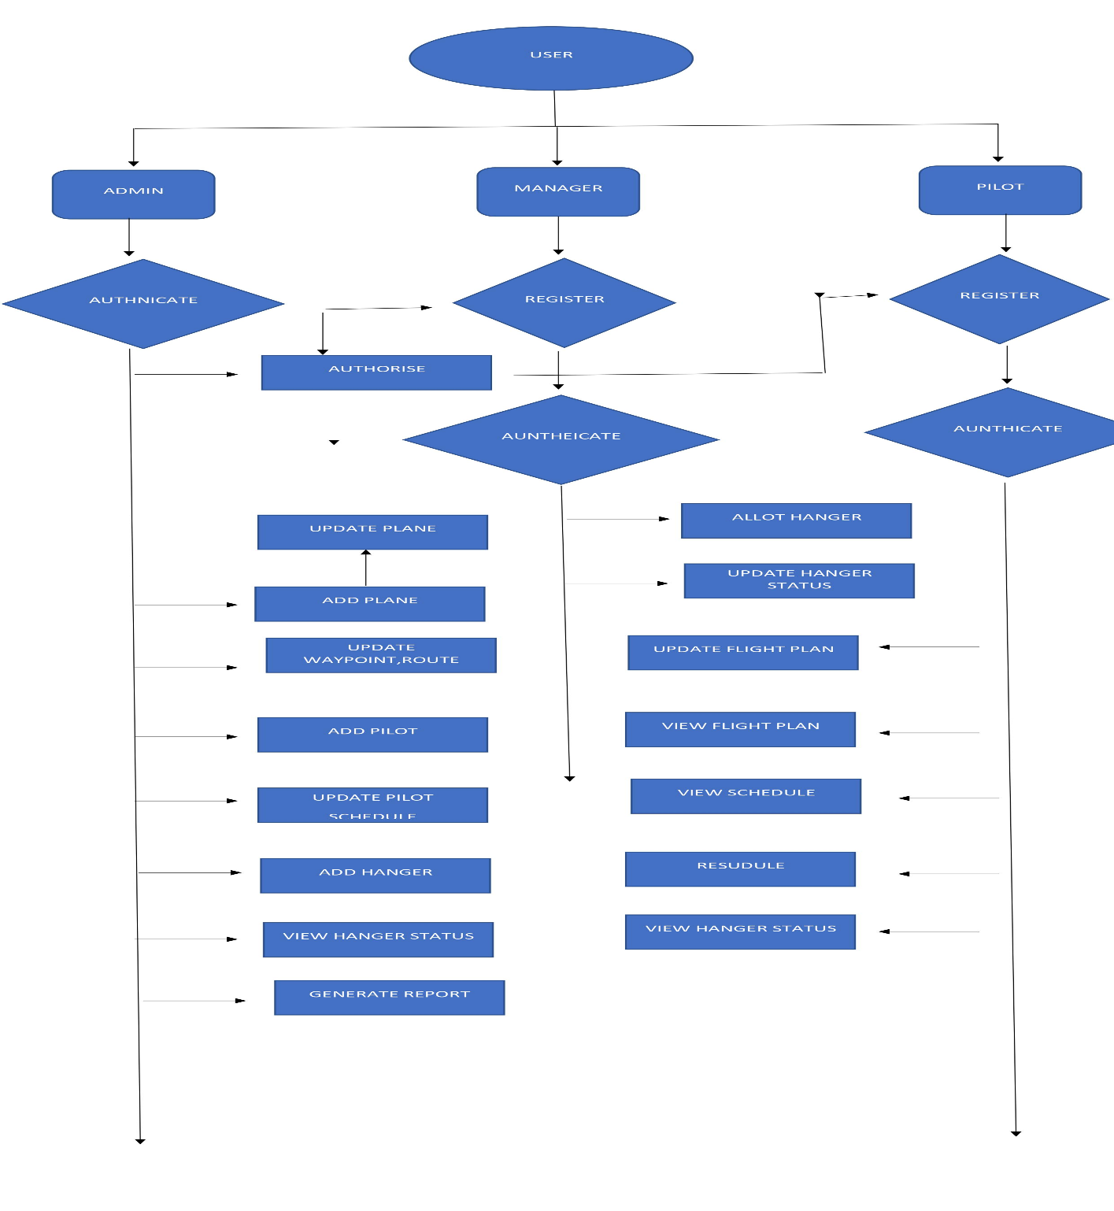



Schematic Diagram

Slide 6
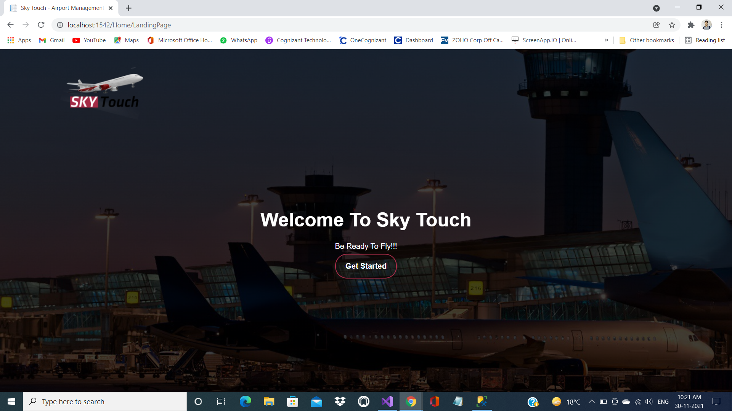
Landing Page

Slide 7
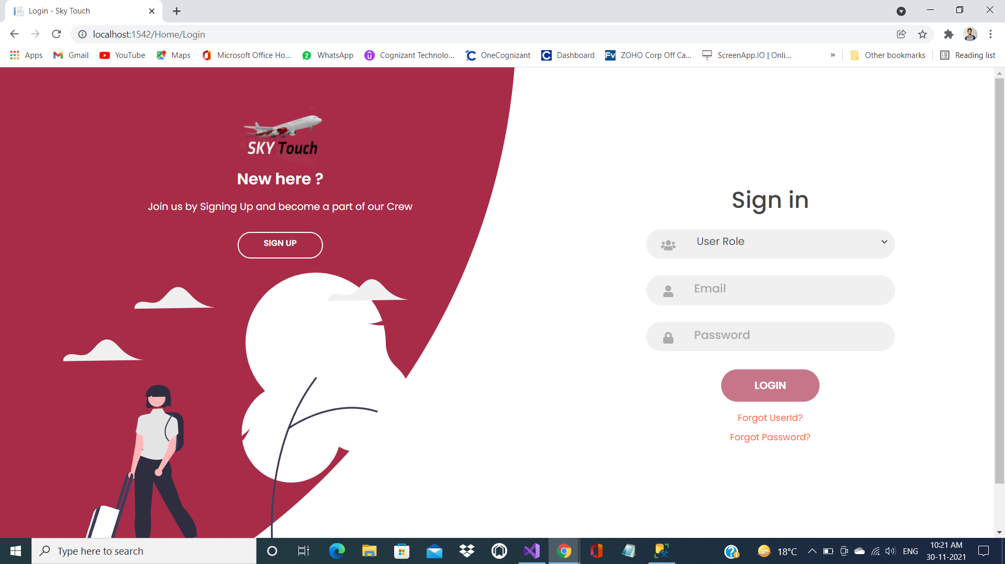
Sign in

Slide 8
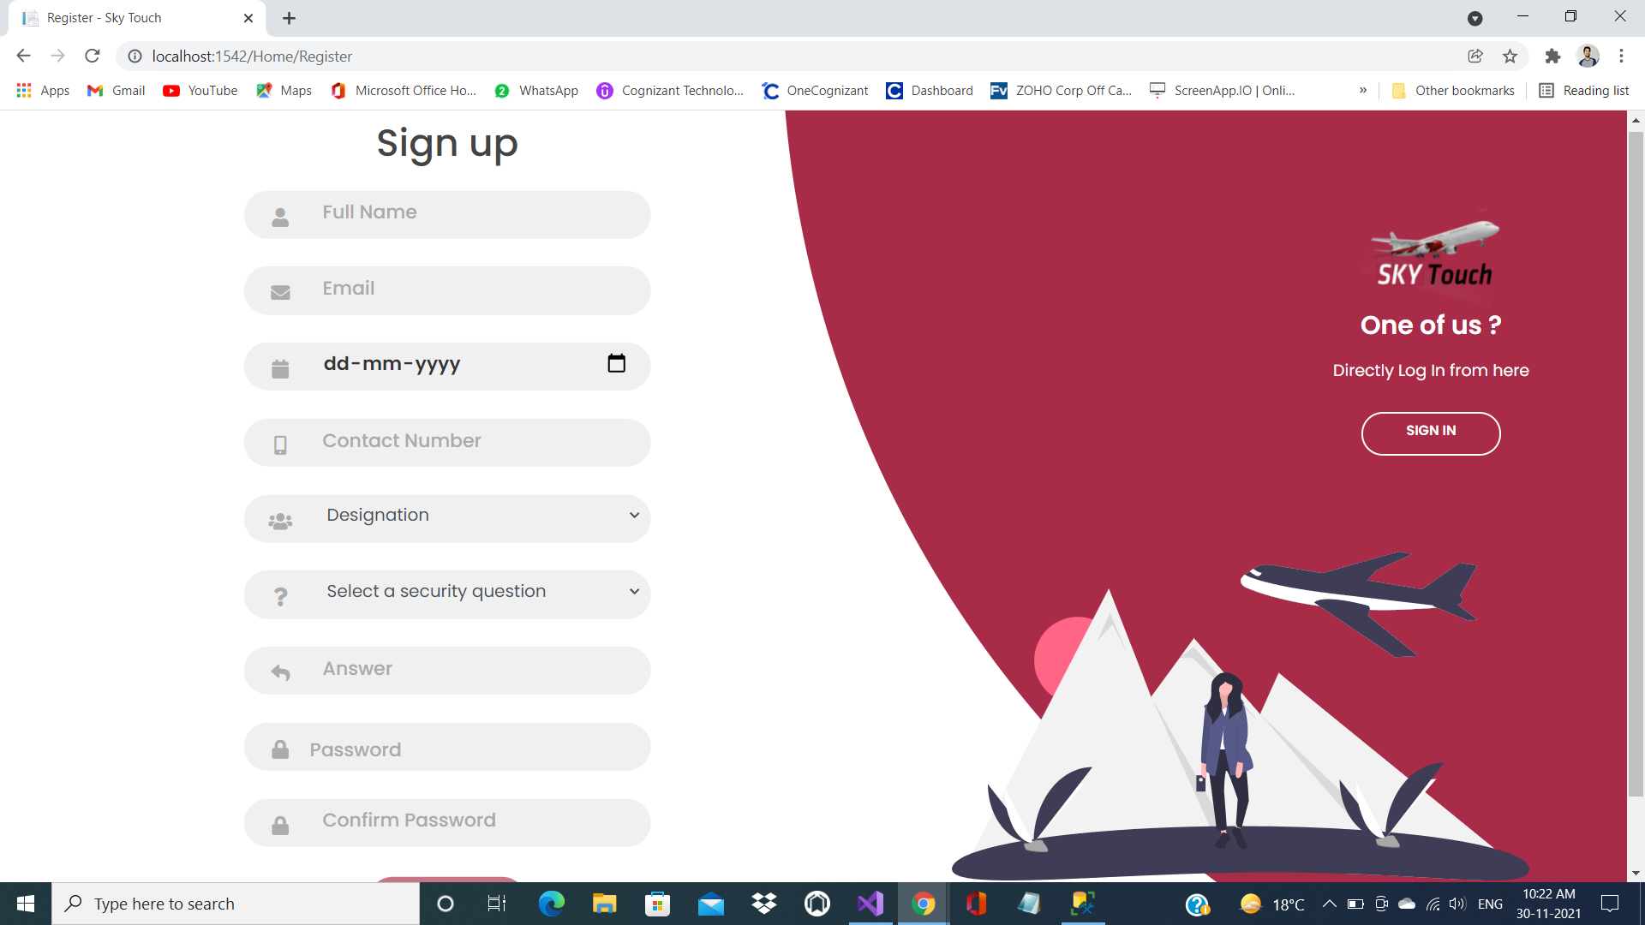
Sign up

Slide 9
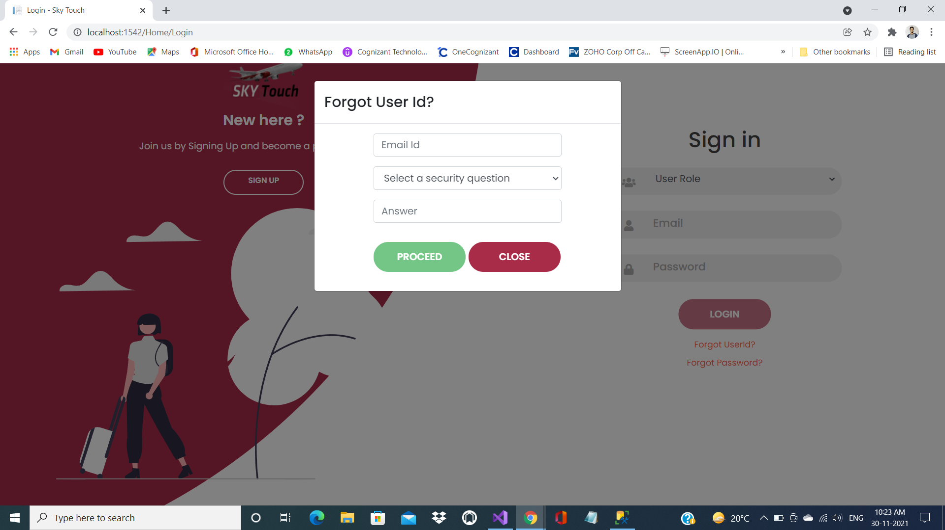
Forgot User Id

Slide 10
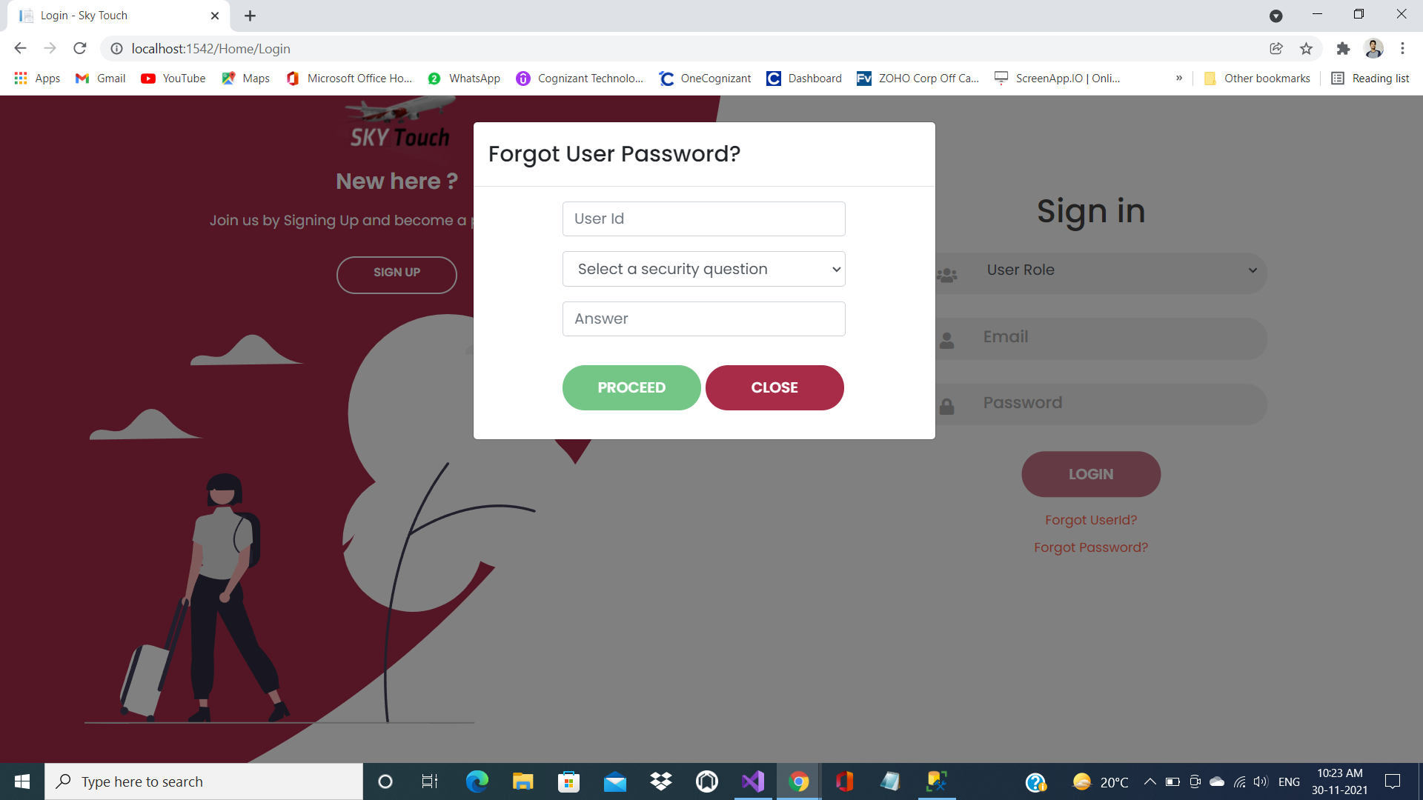
Forgot User Password

Slide 11
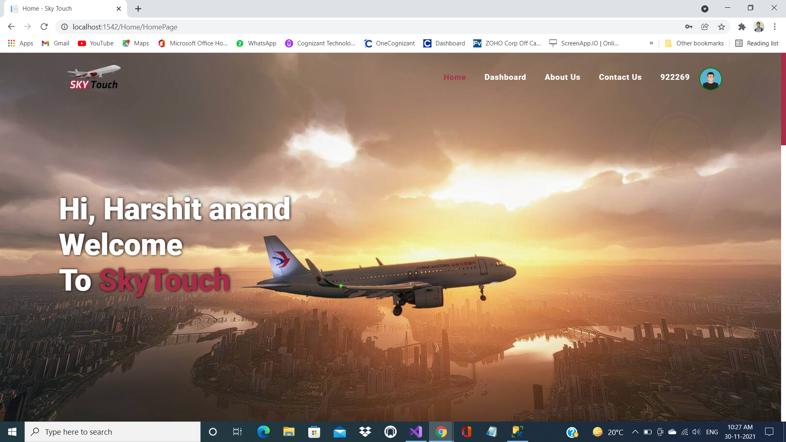
HomePage

Slide 12
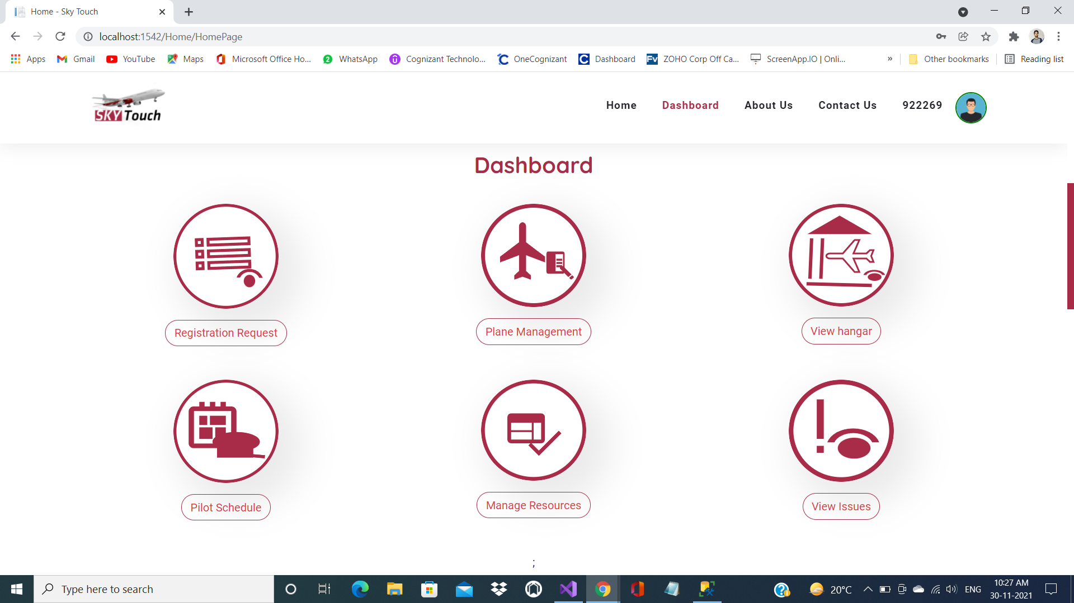
Dashbord

Slide 13

About Us

Slide 14
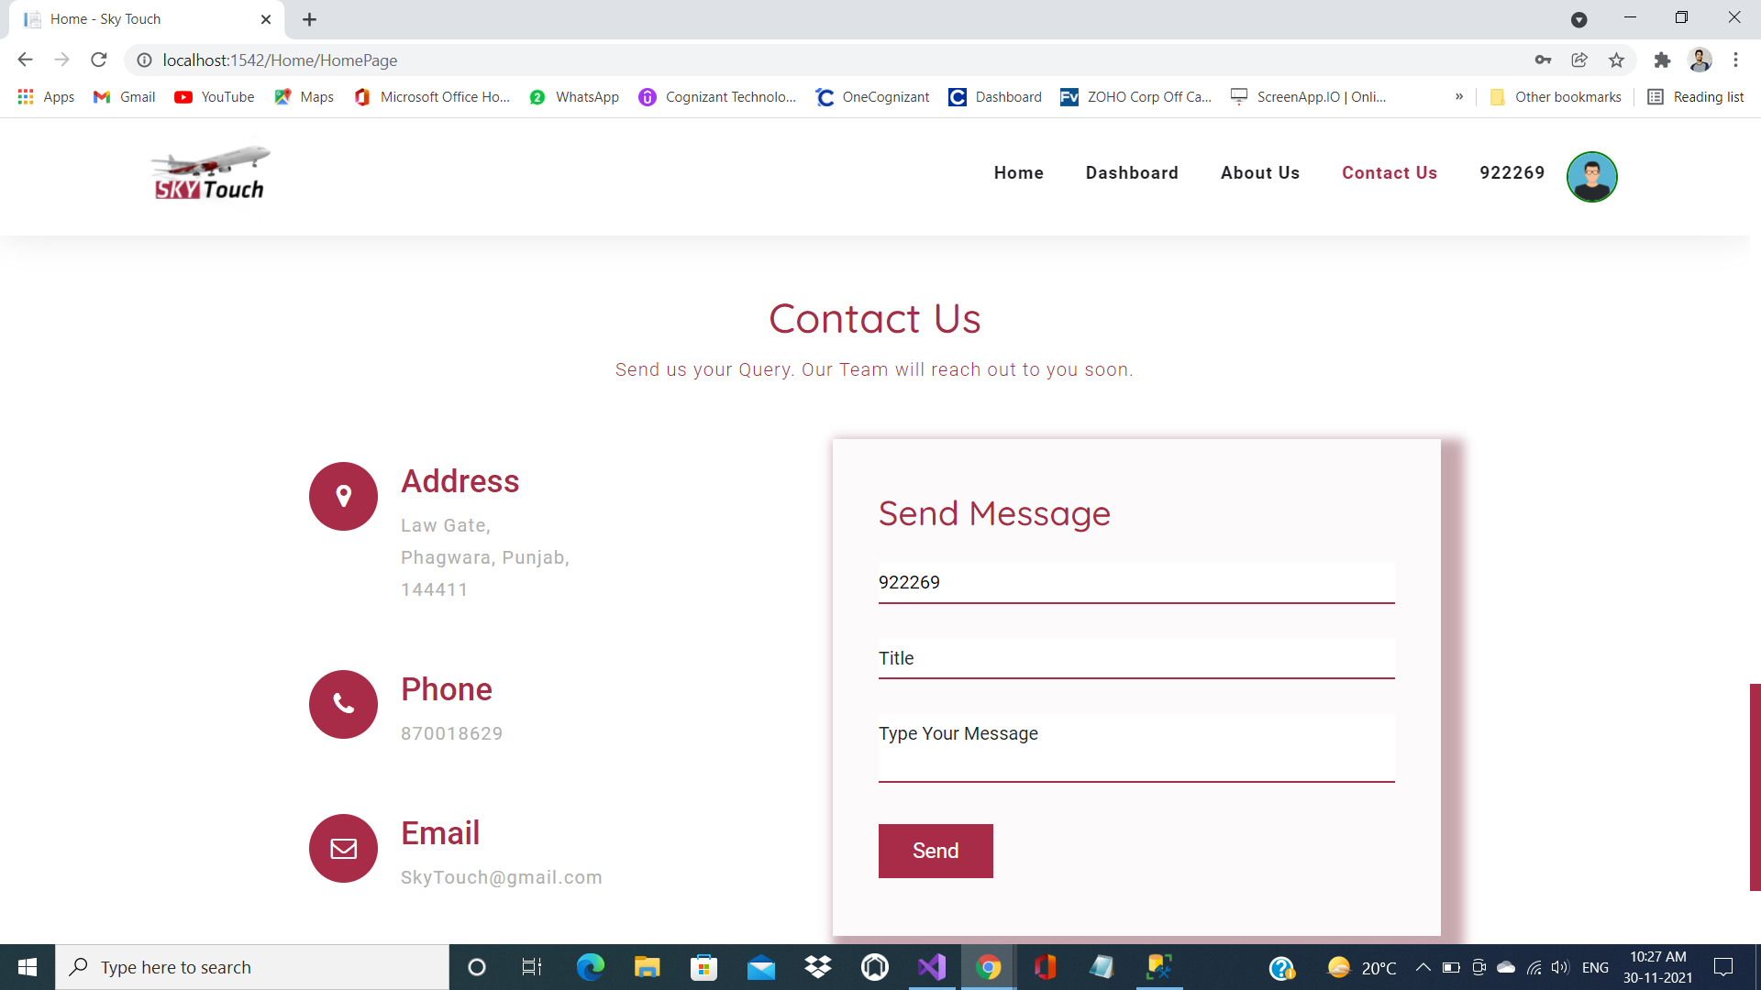
Contact Us

Slide 15
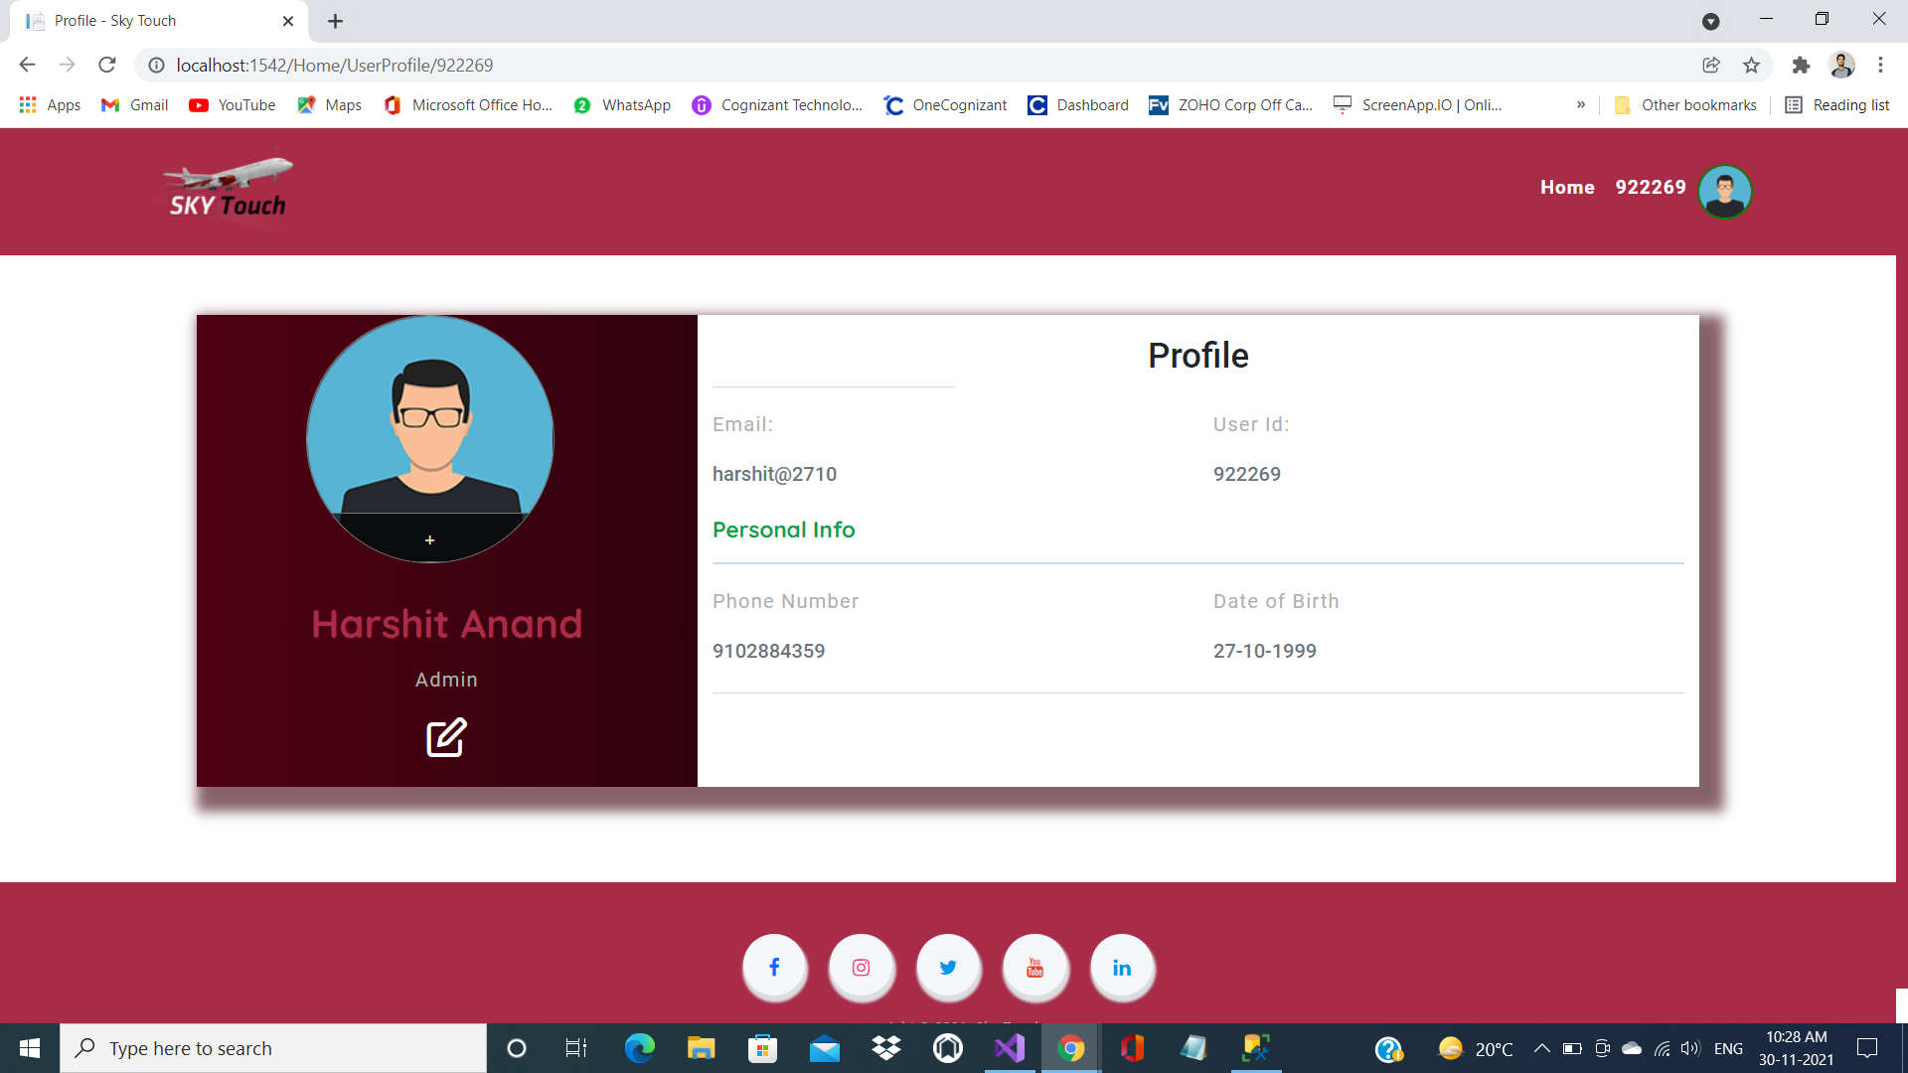
Profile

Slide 16
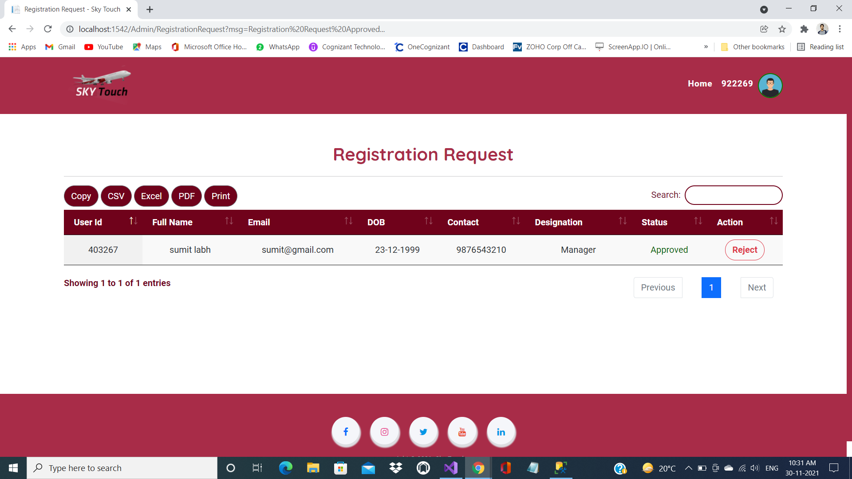
Registration Request

Slide 17
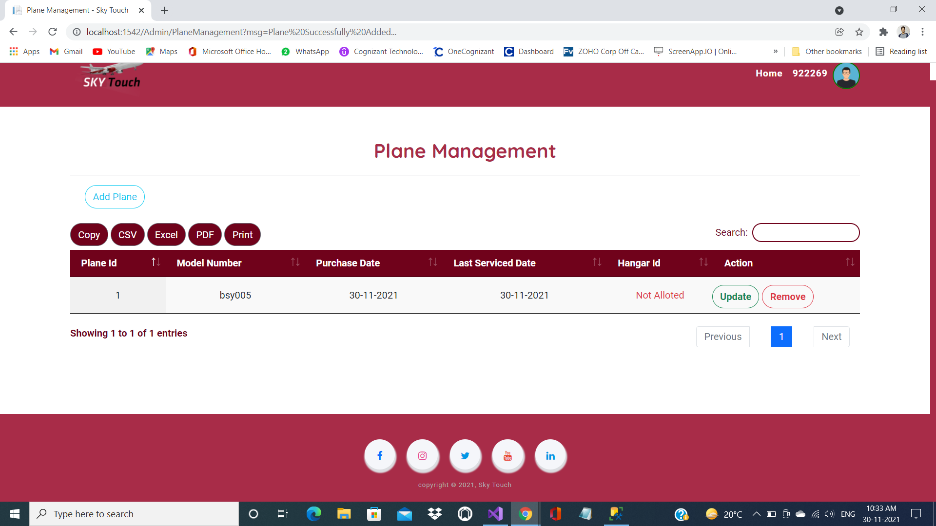
Plane Management

Slide 18
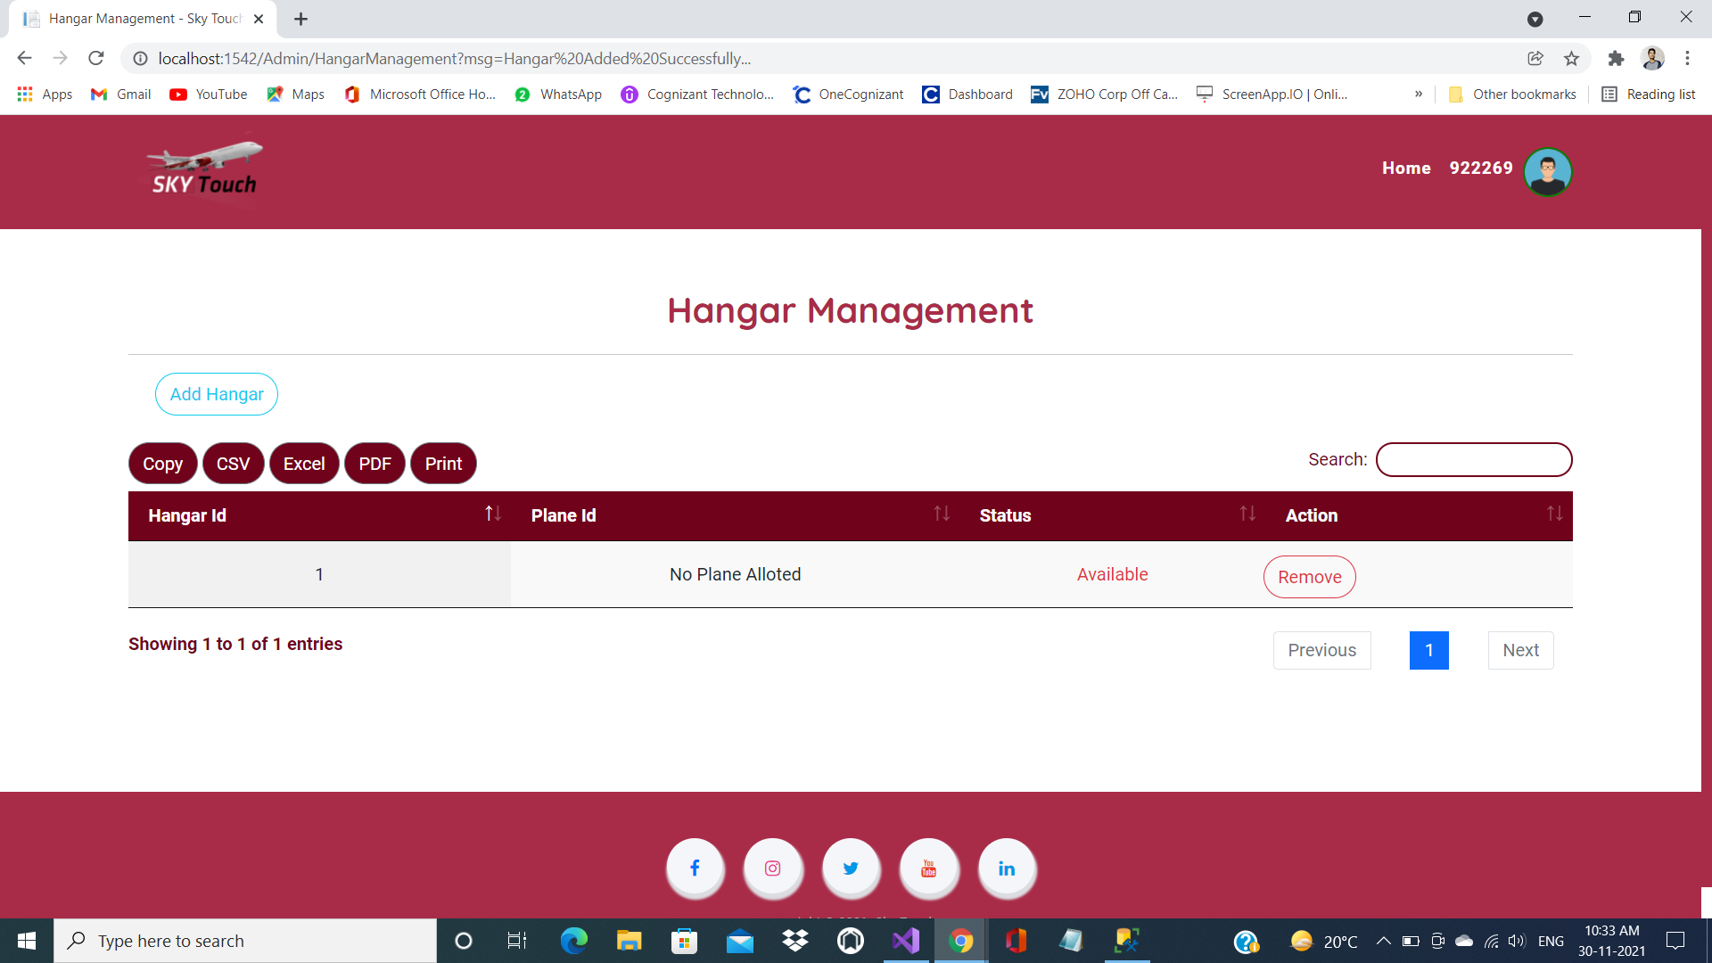
Hanger Management

Slide 19
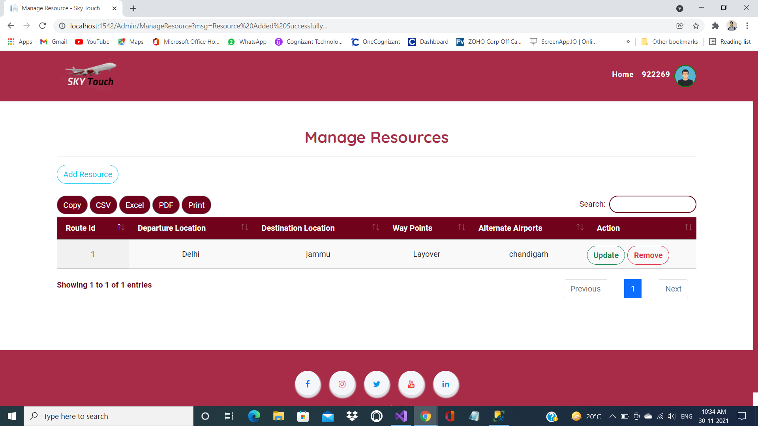
Manage Resources

Slide 20
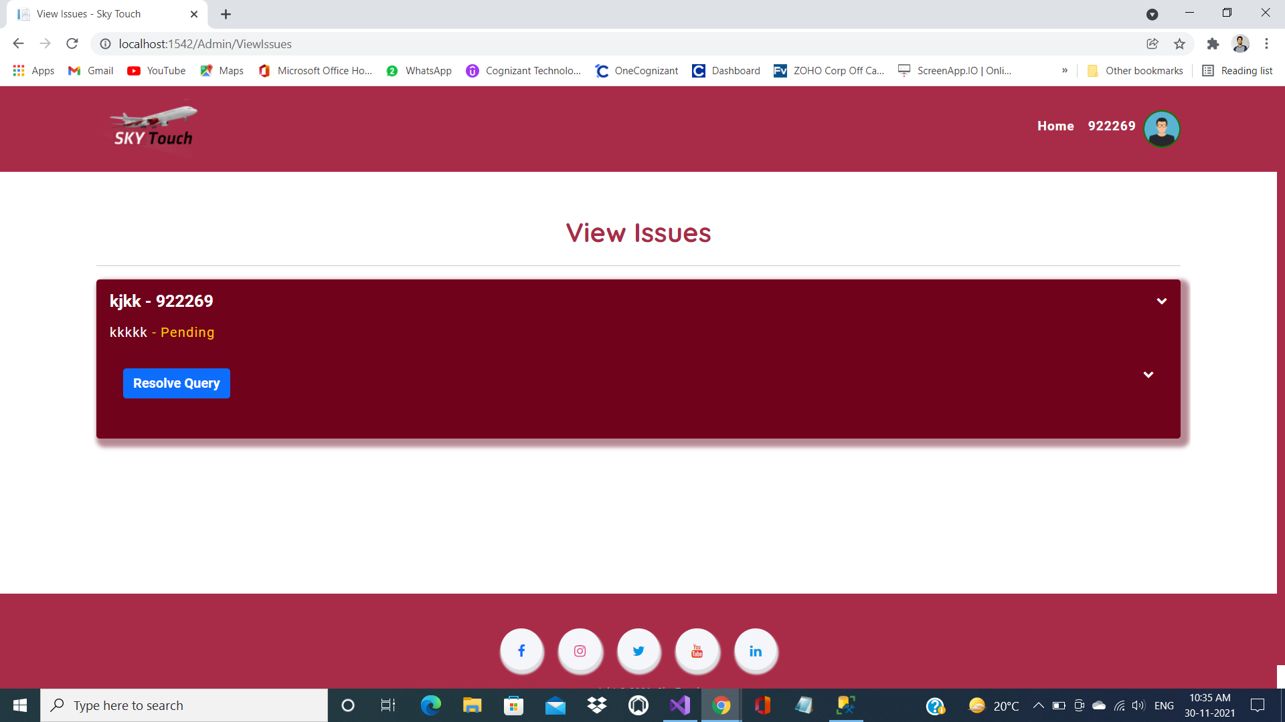
View Issues

Slide 21
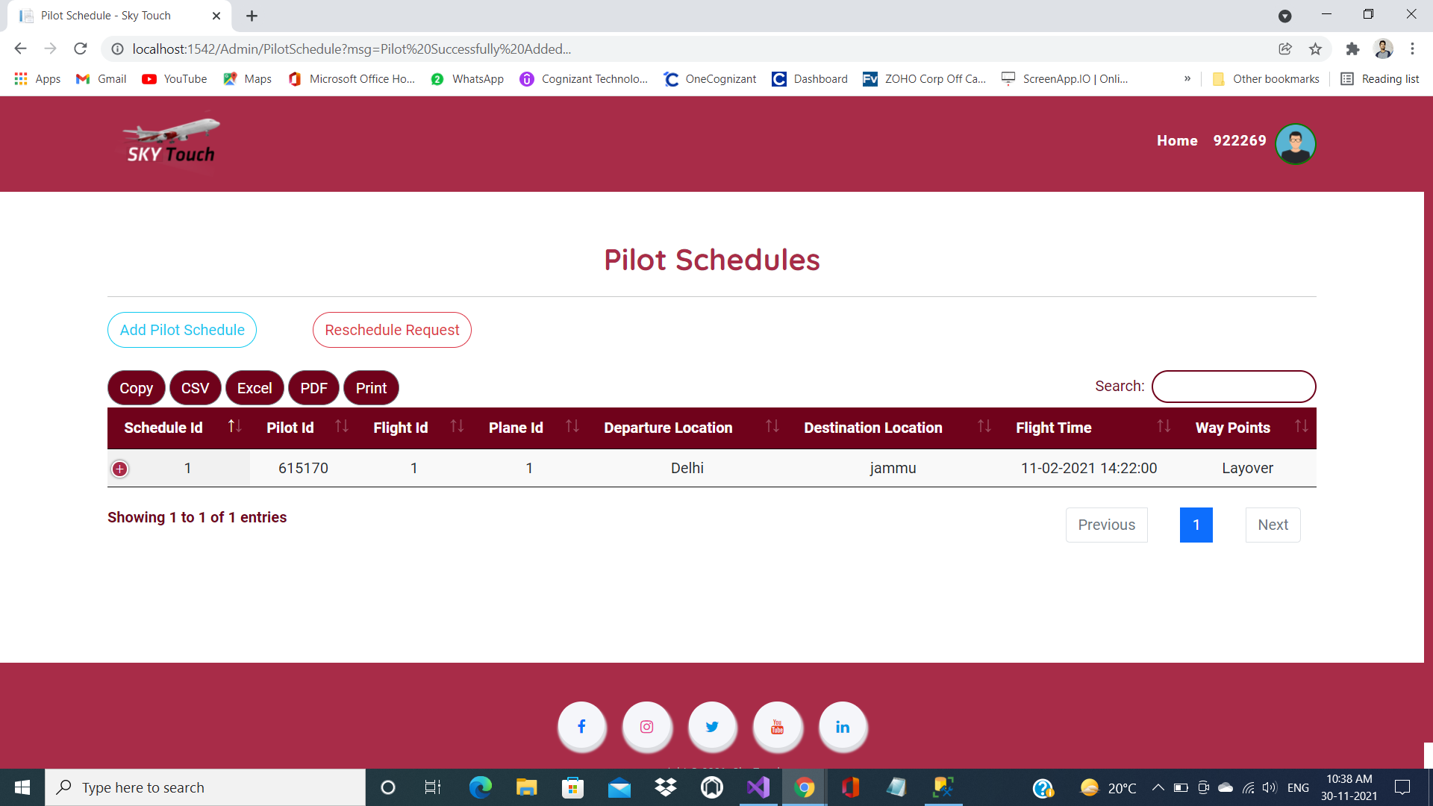
Pilot Schedules

Slide 22
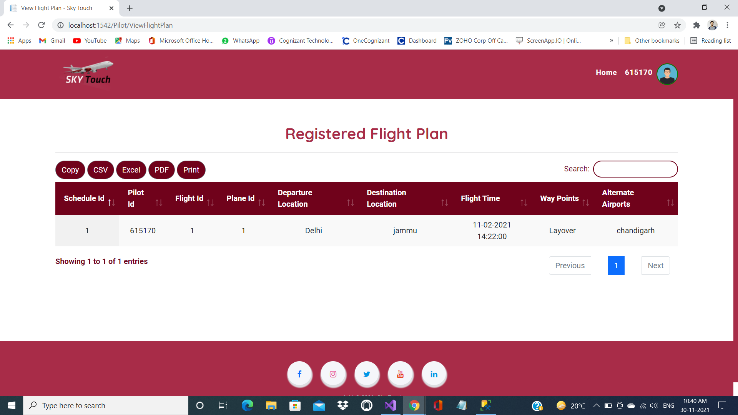
Registered Flight Plan

Slide 23
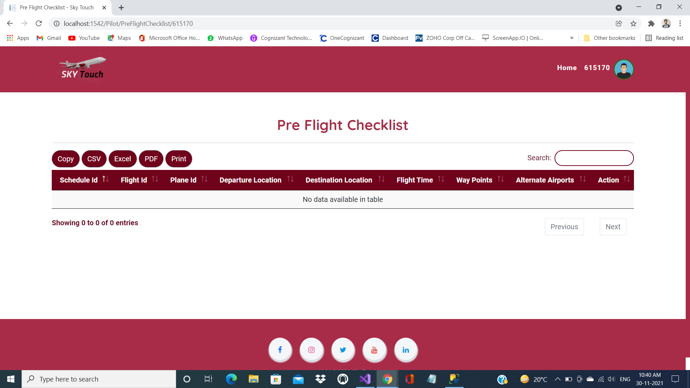
Pre Flight Checklist

Slide 24
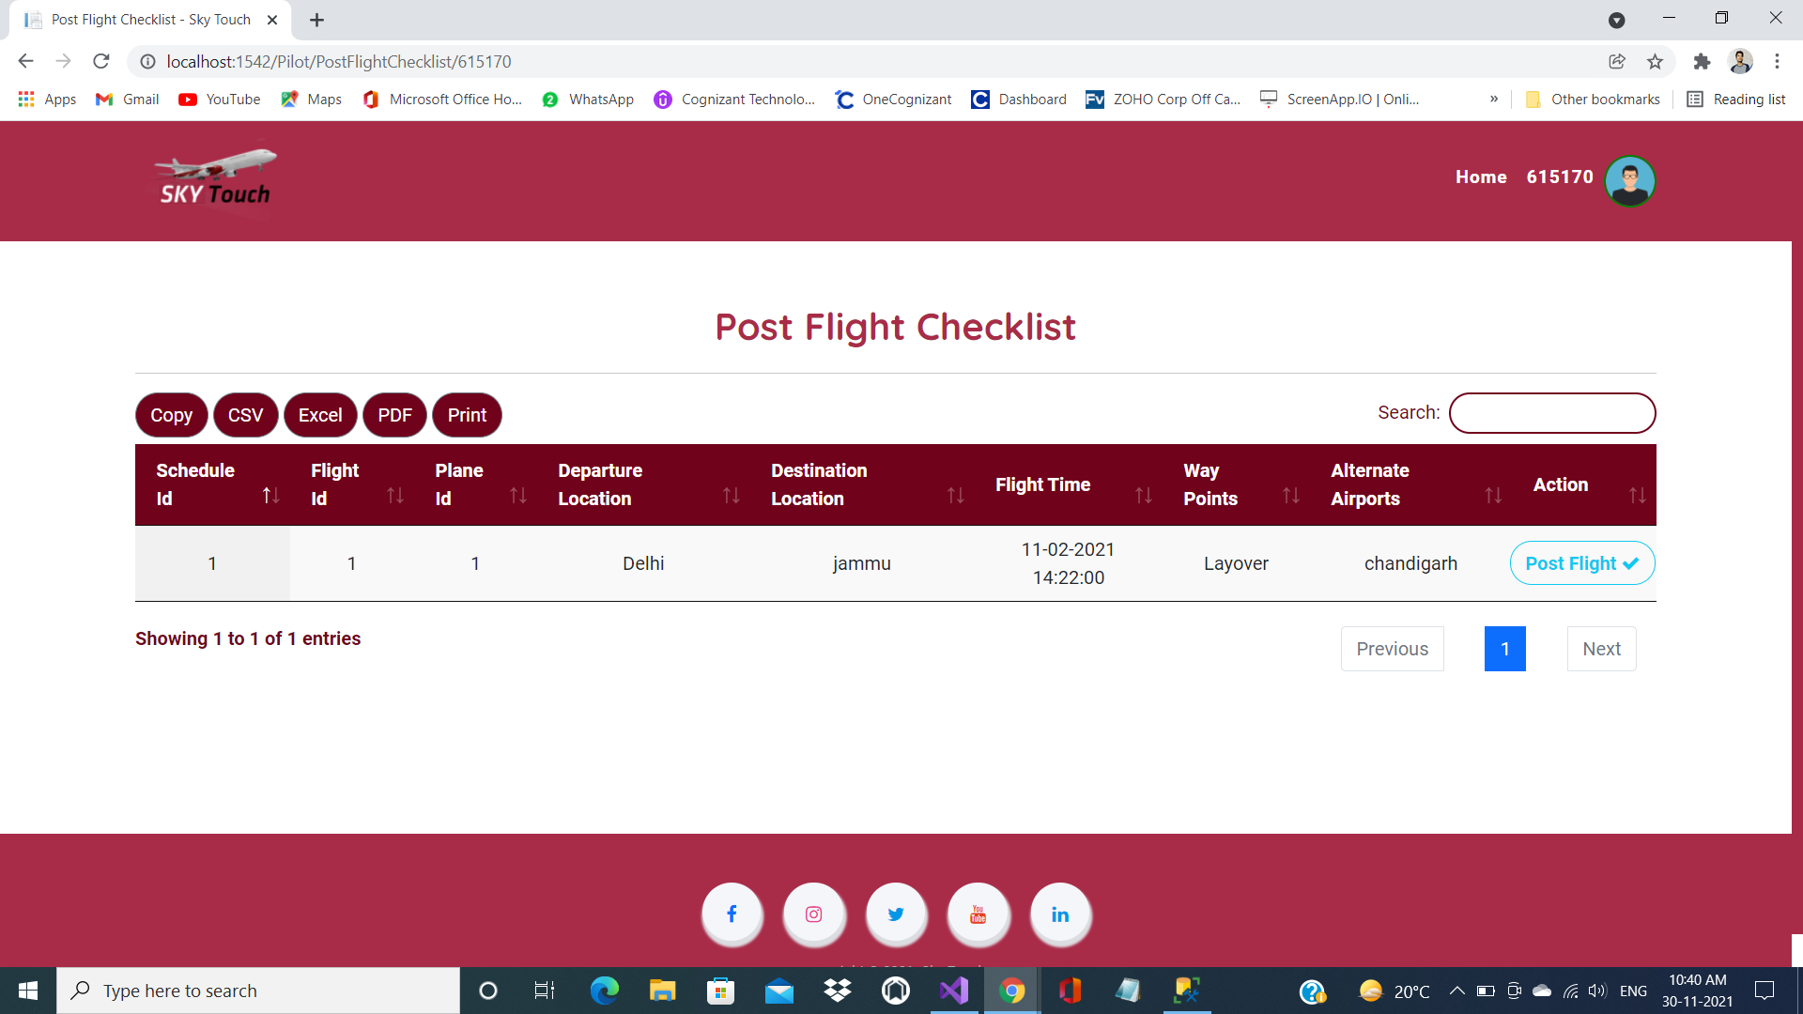
Post Flight Checklist

Slide 25
Post Flight Checklist

Slide 26
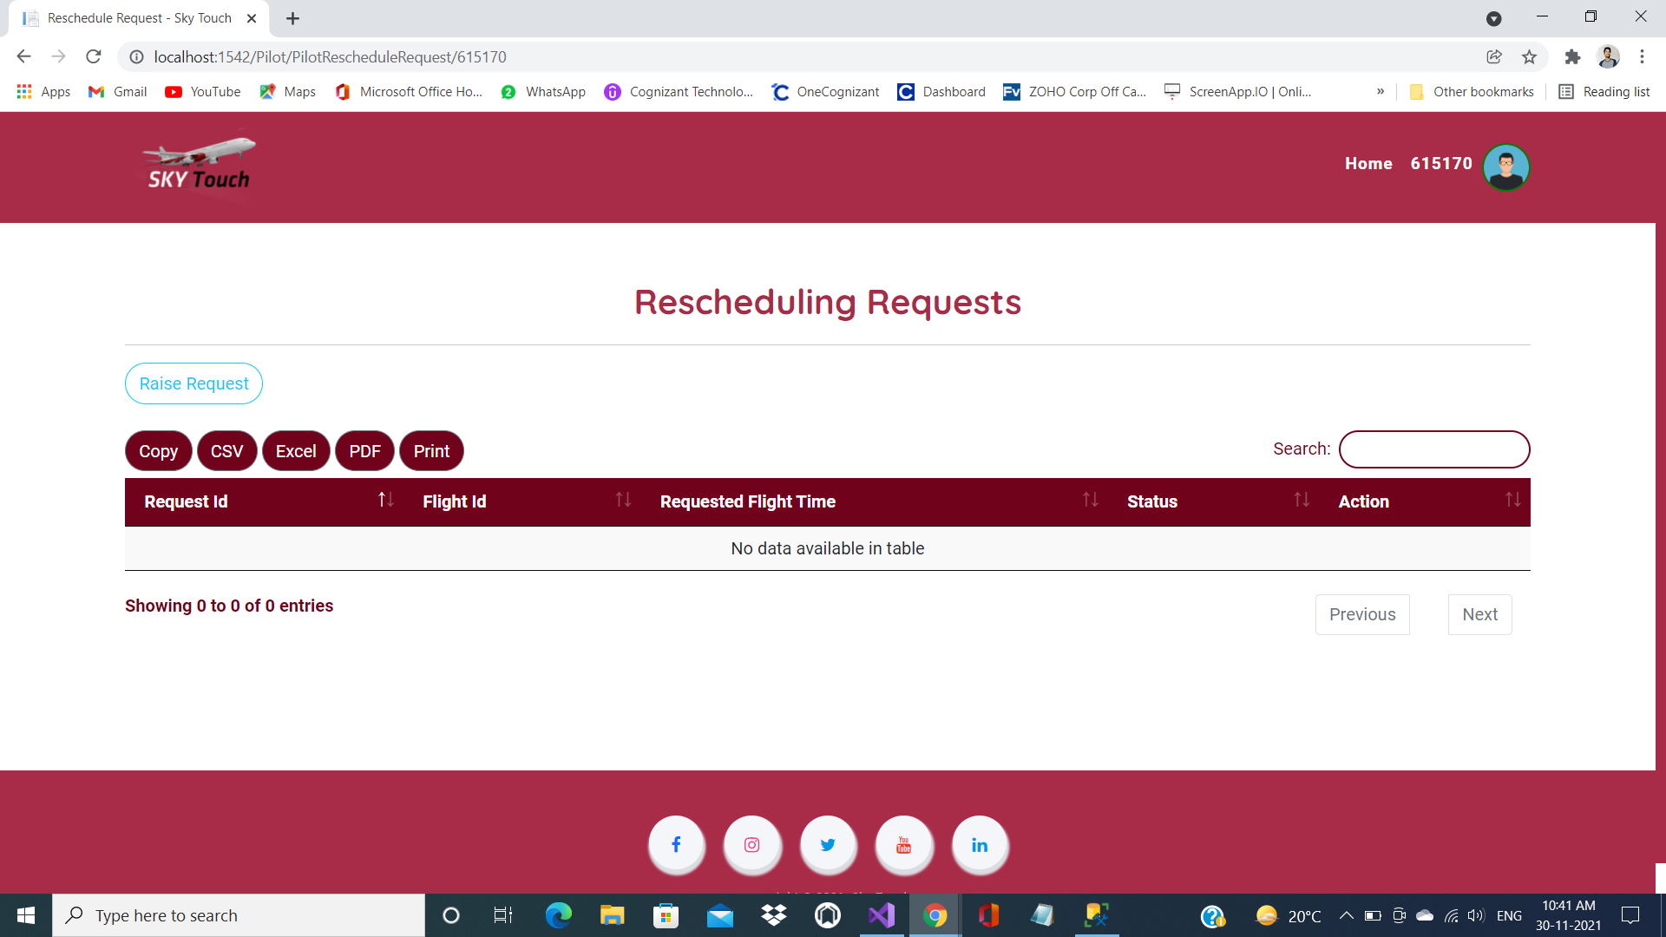
Rescheduling Requests

Slide 27
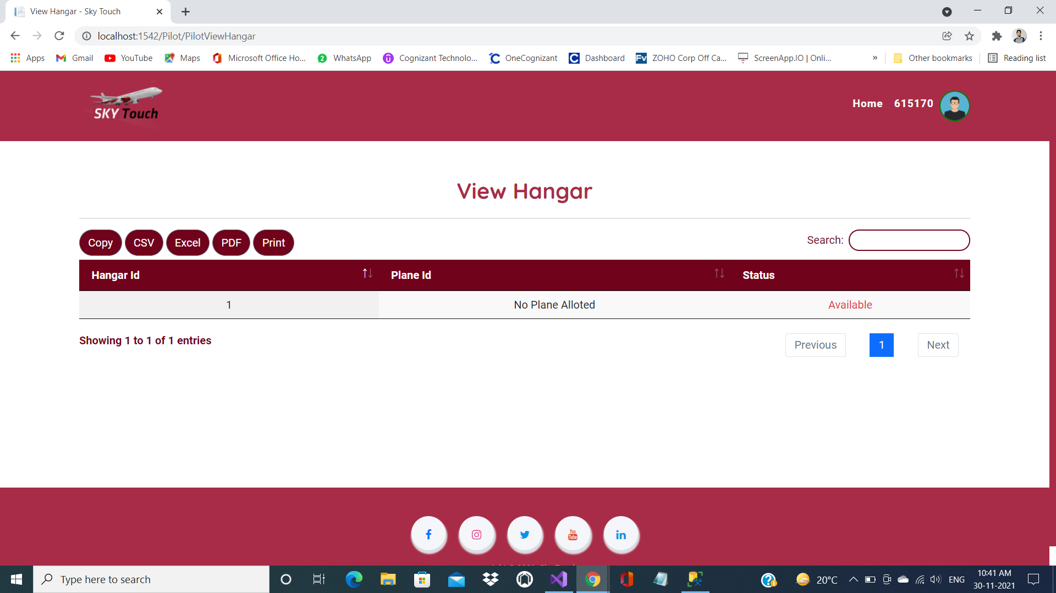
View Hanger

Slide 28

Hanger Management

Slide 29
Future Scope
This project provides a facility to digitalize the modern airport management system. It is time saving as it allows the admin to keep count on the status of flights and the management of all the customers in a very efficient way. A well-chosen system will save the valuable administration time, lead to a better experience.

Slide 30
Thank You

